Slide 1


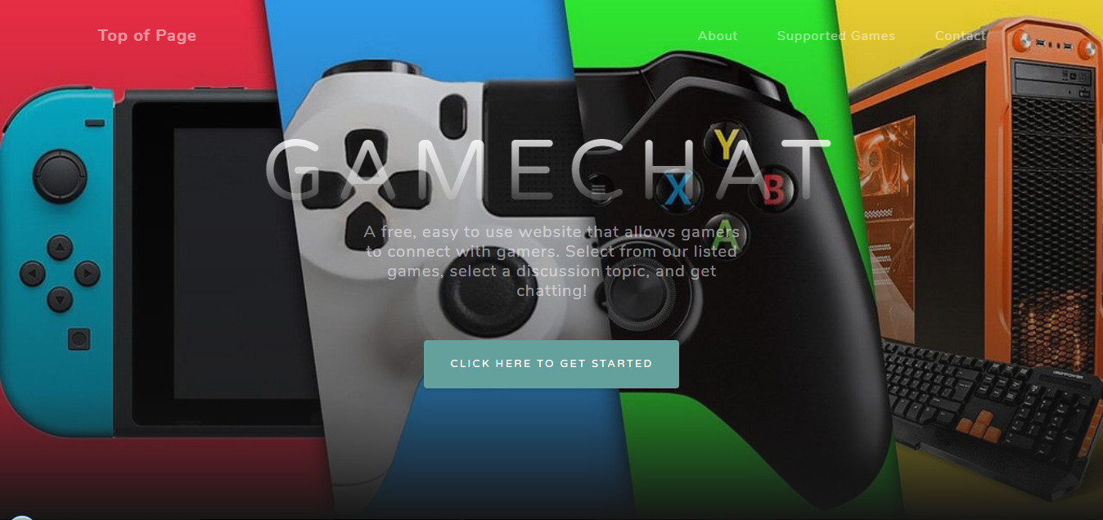
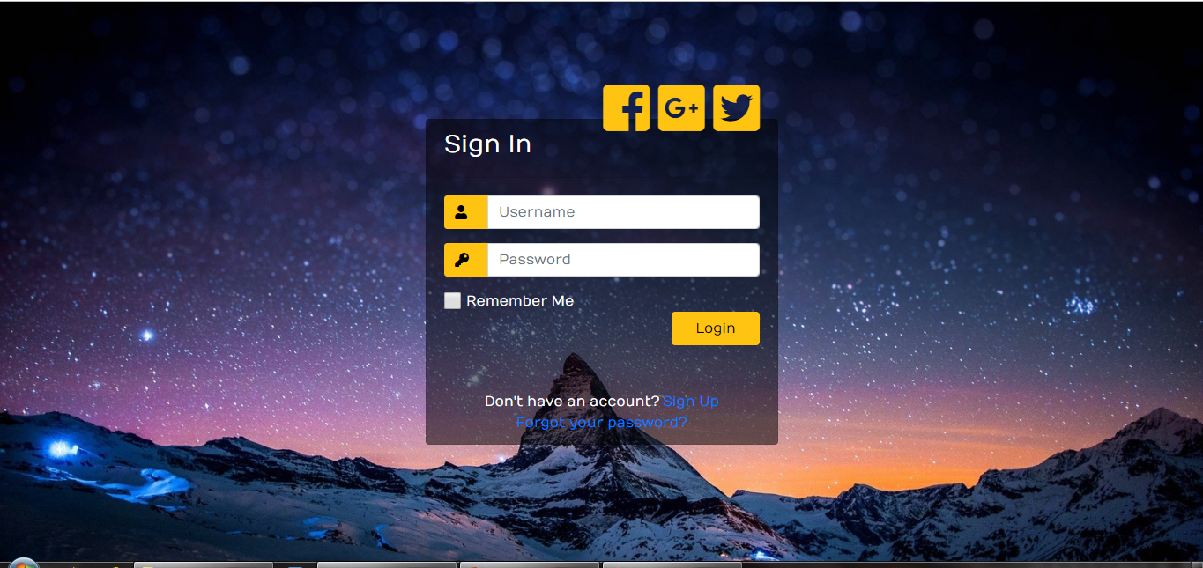

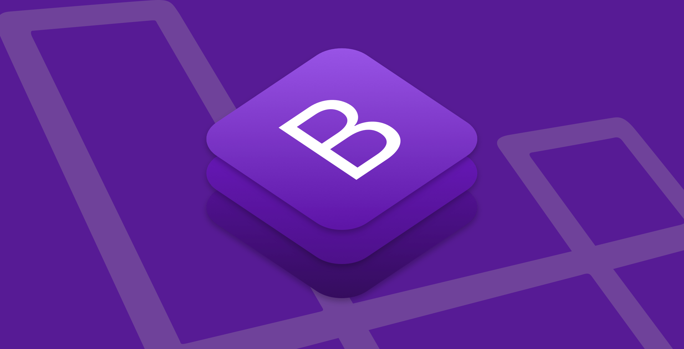
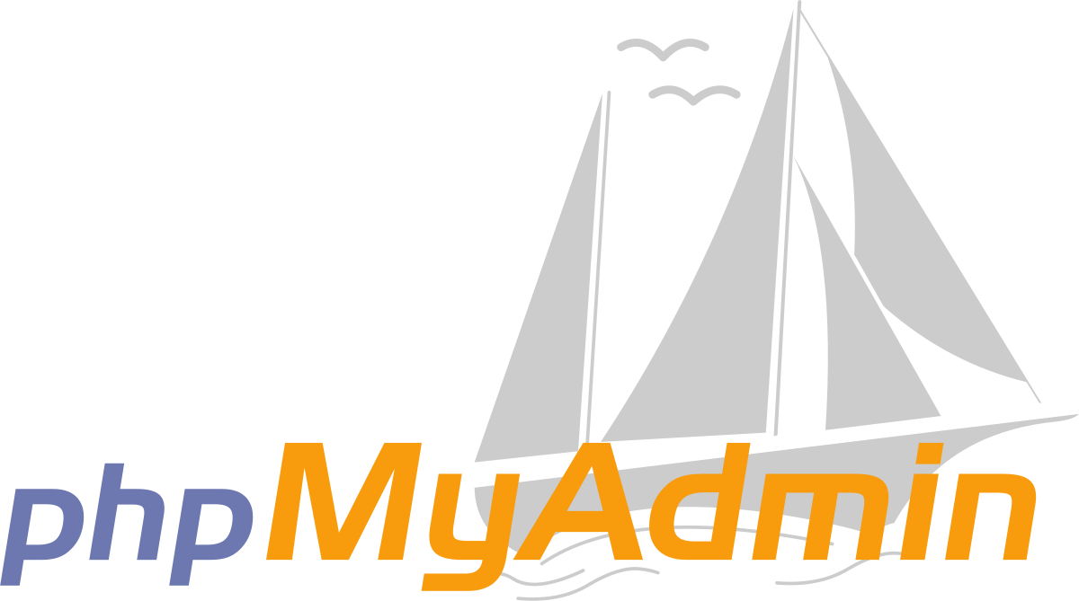
REPLACE THIS BOX WITH YOUR ORGANIZATION’S
HIGH RESOLUTION LOGO
GameChat – A Website About Chatting with Gamers
REPLACE THIS BOX WITH YOUR ORGANIZATION’S
HIGH RESOLUTION LOGO
Dustin Young
Senior Projects – CSC 493
Berea College – 2019
Project Concept
Project Vision
Project Scope
GameChat is being designed as a way for gamers to chat about the games that they play. Since everyone likes different genres of games, it can be hard to always find someone who plays the same things that you do.
GameChat is separated into different discussion boards, and then into different sub-topics. This ensures that users can always find something to talk about.
GameChat will feature several different discussion boards, which will then be further separated into different sub-topics:
Lore
General Discussion
Players Helping Players
Player Feedback
This site is also heavily inspired by Reddit and GameFaqs.
While the website will allow people to make posts as they please, the number of supported games will be relatively low, relative to other similar sites, since each discussion board will be added manually.
Since games must be added manually, the site will not support many at launch. Most likely, the ones supported will be as follows:
Destiny
Warframe
Anthem
League of Legends
Hollow Knight
Architecture and Design
Users will be able to sign up for an account, after which they may log in to the site in order to use the features, or simply to manage their account information.
The landing page should clean and uncluttered, as well as easy to navigate.
The user navigates to the website, and is taken to the landing page. Here, they may either browse through the site to learn more about the discussion boards, or they may create an account/log into an existing one.
Requirement Specification
Since GameChat is a relatively simple website, its requirements are also relatively simple.
Any modern computer with a stable internet connection should be able to connect to and make use of GameChat.
As for installing it on a server, the requirements are as follows:
Flask must be installed on the computer
phpMyAdmin is required as well to manage the database.
Conclusions
Flask and Bootstrap are extremely useful for web development.
In addition, Bootstrap easily scales to multiple devices for compatibility.
phpMyAdmin is a fantastic tool for managing a database.
Although the website still needs more work to be considered complete, I have learned a ton from it.
Contact
References
Dustin Young
Berea College
Email: dustinkyoung15@gmail.com
Phone: (606) 282-8375
https://getbootstrap.com/docs/4.0/getting-started/introduction/
http://flask.pocoo.org/
https://startbootstrap.com/themes/grayscale/
https://www.phpmyadmin.net/

